Slide 1
Real Time Systems - Embedded Electronic A
Handling Aperiodic Overloads
Yashodhan Vishvesh Deshpande
yashodhan-vishvesh.deshpande@stud.hshl.de

Slide 2
Motivation
Overload results in failure to complete task.
Fatal consequences in hard real time systems.
Lower performance in soft real time systems.
Needs handling of overload.

Slide 3
Contents
Periodic vs Aperiodic Overload
Computational Load
Overload and types
Cumulative value
Competitive factor
Classification of algorithms
Robust Earliest Deadline Algorithm

Slide 4
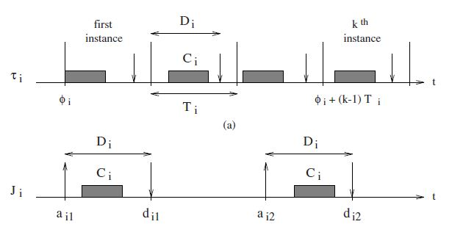
Aperiodic vs Periodic Tasks
Periodic Tasks - Sequence of tasks with regular activation times.
Aperiodic Tasks - Sequence of tasks with irregular activation times.

Slide 5
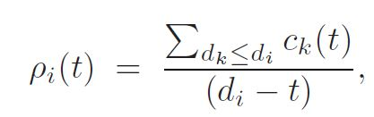
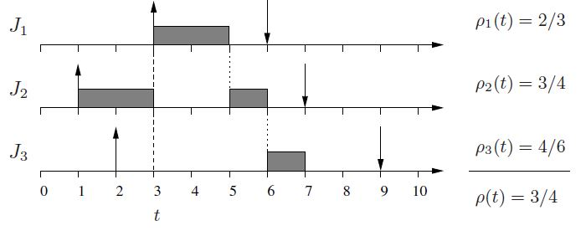
Instantaneous Computational Load
P - load , c – computational time , d - deadline and t- current time
Instantaneous load during a time interval is calculate to determine the load on the system

Slide 6
Types of Overload
When the computational time demand for a task exceeds the available time of a processor then it is said to overload.
Transient Overload -
Average load on the system is below overload conditions.
Load during specific time period is above overload conditions.
Permanent Overload - System is overloaded for unknown time duration.

Slide 7
Cumulative Value of an algorithm
Every task has an arbitrary value assigned to measure its importance.
The arbitrary value can be decided by factors like:
Computation time required.
Ratio of arbitrary integer to required computational time - value density
The performance of an algorithm is defined by sum of the values of each successfully completed task.
Missing a deadline in hard real time system results in cumulative value equal to zero.

Slide 8
Competitive Factor of a scheduling algorithm
Competitive factor ϕ of an algorithm is a number between 0 to 1.
is a measure of minimum cumulative value of that algorithm achieved for ϕ times the cumulative value achieved by clairvoyant scheduling algorithm.
When load is greater than 2 , none of the online algorithm can guarantee a competitive factor of more than 0.25 .

Slide 9
Classification of Algorithms for Overload
Best effort - no prediction for overload conditions
With acceptance test - verifies the schedule of the task set but rejects tasks which overload the system
Robust - separate timing constraints and importance, send overloading tasks back to the queue.

Slide 10


Robust Earliest Deadline Algorithm
The residual laxity L of a task is defined as the interval between its estimated finishing time f and its primary deadline d.
Graceful degradation in overloads, deadline tolerance, and resource reclaiming.
Maximum Exceeding Time

Slide 11
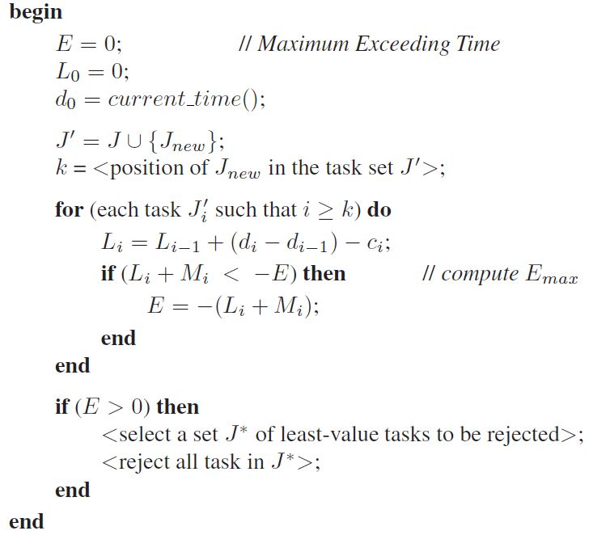

Slide 12
Conclusion

Slide 13
Thankyou
Yashodhan Vishvesh Deshpande
yashodhan-vishvesh.deshpande@stud.hshl.de

